Slide 1

MSCA 31013
Big Data Platforms
TLC Trip Record Data Yellow Taxi
Benjamin Cox, Dharmi Gala, Naman Mehta

Slide 2

Project Overview
Overview:
Our project attempts to analyze the Yellow Taxi trip data collected by the NYC Taxi and Limousine Commission. Our goal in this analysis is to determine if this data can provide meaningful insights around taxi user behavioral data, tipping and pricing, and potentially exogenous factors like COVID or weather data that may have impacted user behavior.

Slide 3
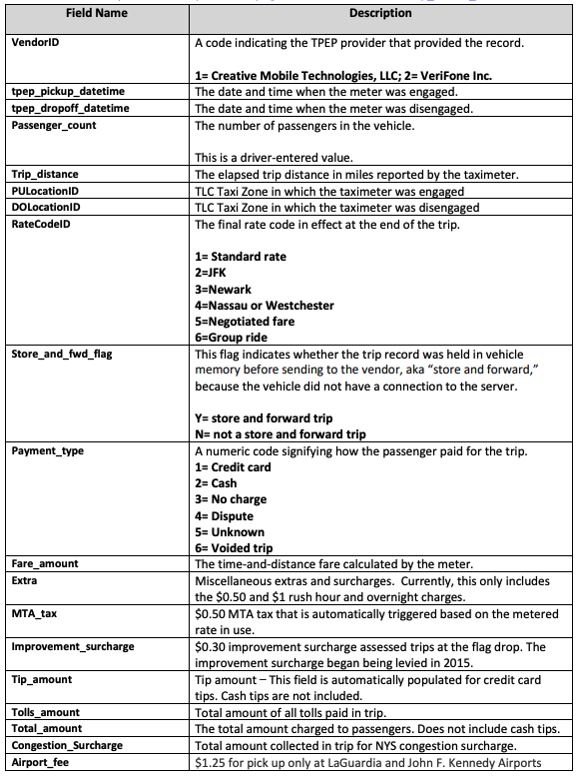
Dataset Overview:
Our consisted of 29 GB of parquet files via Kaggle
We then hosted this data in Google Cloud and loaded our data into Python using spark.
The data contains several numeric and categorical data we can use to predict trip prices and other charge and location based information such as:
Pickup and drop off times and locations
Passenger count
Distance
Rate code
Payment type
Fare Amount
Extra surcharges
Tips, tolls, surcharges, and airport fees

Slide 4

Business Case: Cab Viability and Price Sensitivity
Overview:
In recent years since the rapid onset of ride sharing platforms such as Uber and Lyft, many cities in the United States have witnessed deep conflict between these methods of transportations and their drivers. Especially due to the fact that many of these traditional cab companies are often subsidized or supported by local governments, it creates a very difficult problem to solve around the relationship with traditional cab businesses as go to methods of travel for people. Some examples methods worth looking at:
Average Volume of Fares Over Time
Price Sensitivity to Exogenous Variables
Price increases and zone selection effect on total volumes

Slide 5
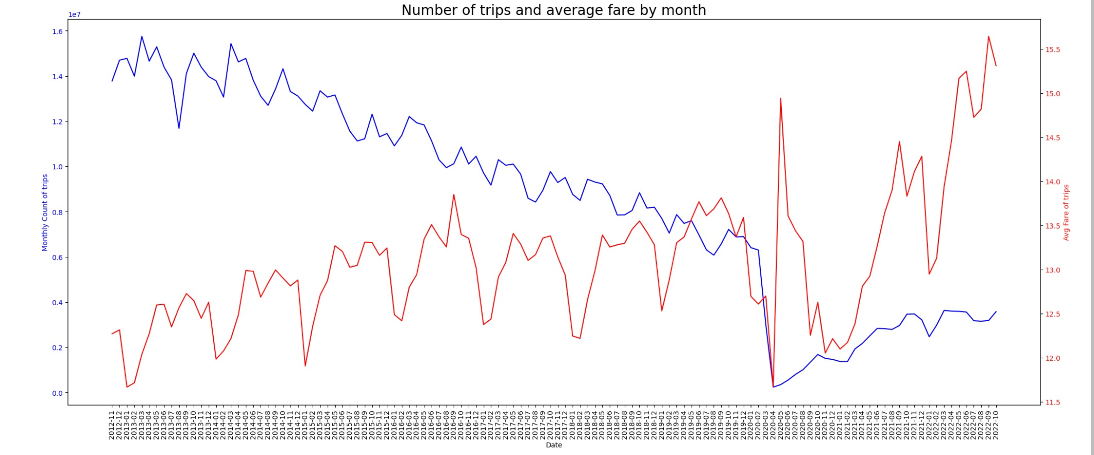
Exploratory Data Analysis: Trend
To further analyze this business case and use a handful of descriptive statistical measures before doing any predictive modeling we wanted to compare volume vs. price vs. time. We can see in the 10 years of our data set, the trend on cabs taken is distinctly down, while the trend on price is distinctly up. We can also see aggressive deviations from trend surrounding COVID-19.

Slide 6
Exploratory Data Analysis: Trend
We see an R2 on linear regression on number of trips to be .9006 over the entirety of our dataset

Slide 7
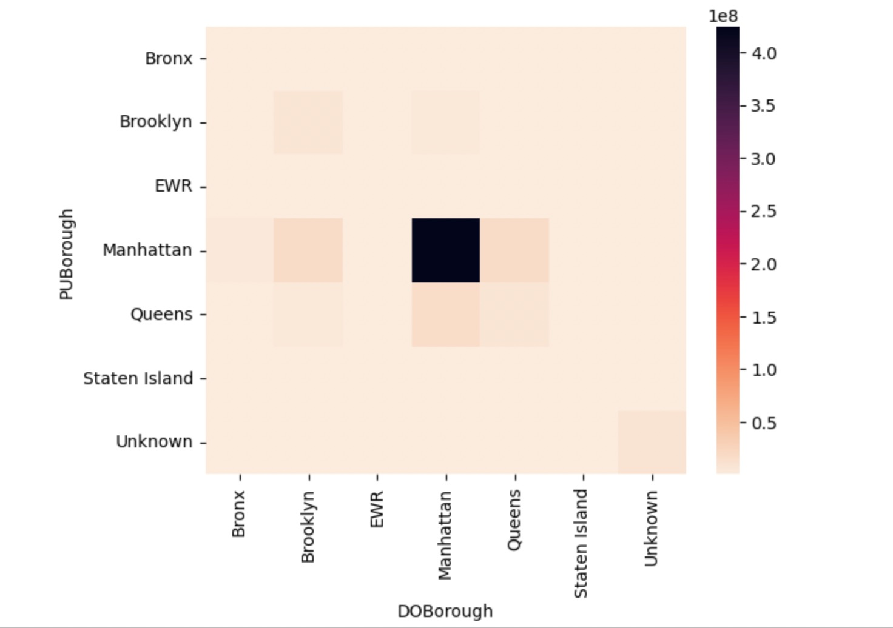
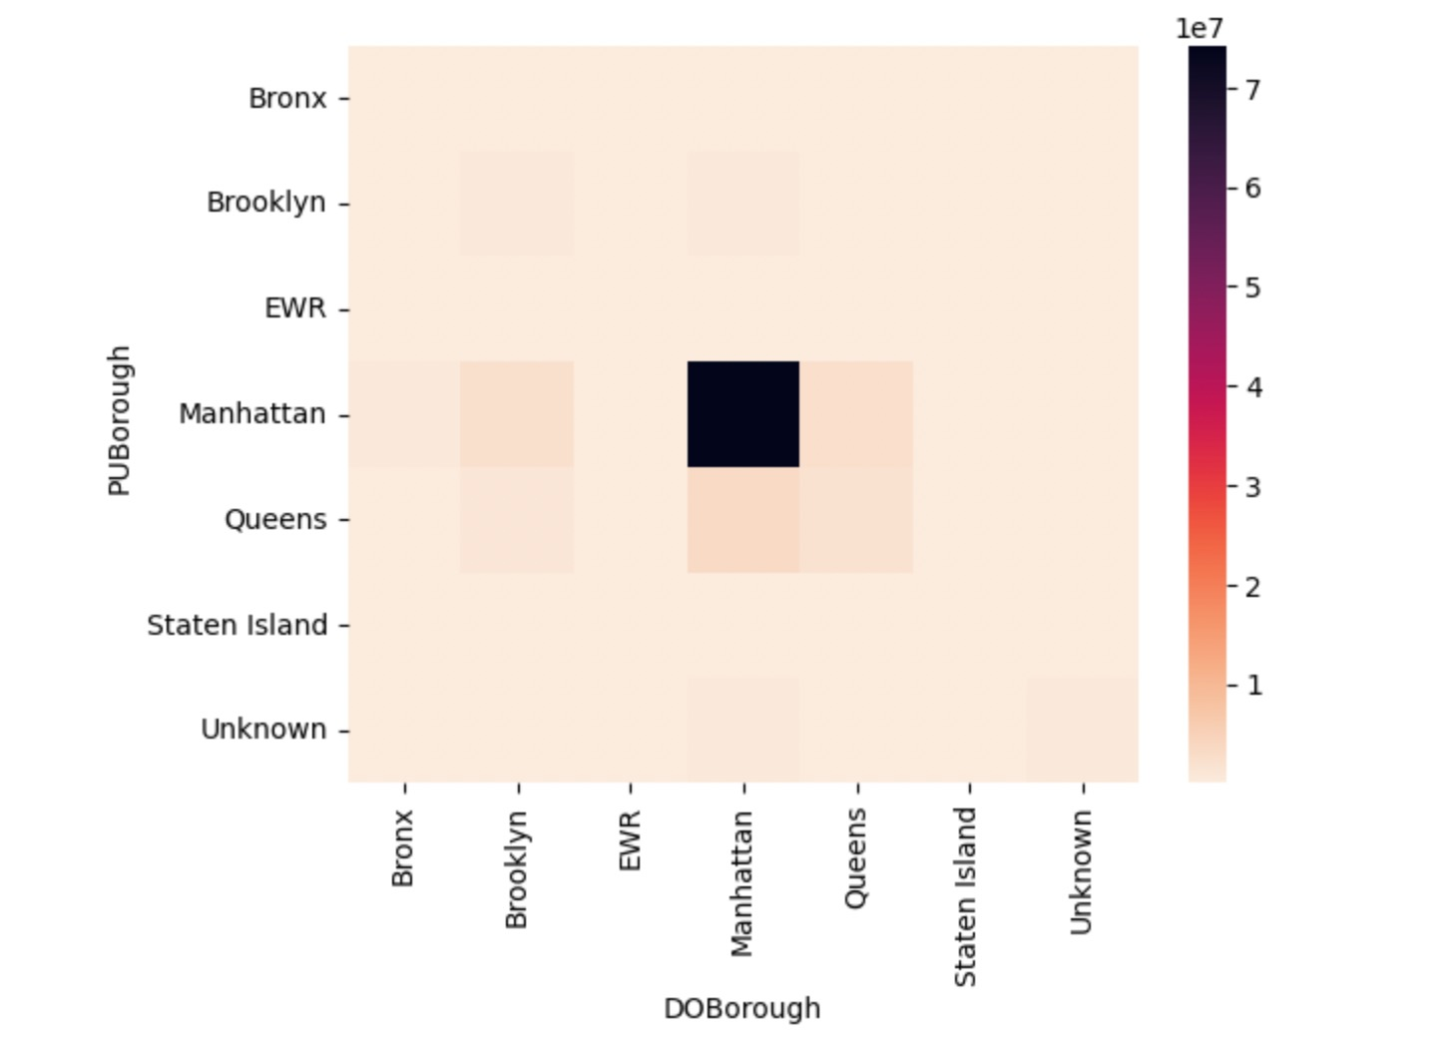
Exploratory Data Analysis: Boroughs
In addition to overall macro trends, we also wanted to check intra-borough to determine what really makes up most of the volume and what neighborhoods tend to cross-pollinate the most. We also wanted to see if this changed in the earlier parts of our data set (pre-rideshare) and most recent data (heavy rideshare footprint). The most notable differences being a decline in BK-BK pair an increase in the Queens-BK pair. Overall inside Manhattan is the lions share
2012-2015
2020-2022

Slide 8







Data Pipelining
Data Sourcing
Data Hosting
Pre-Processing
Feature Engineering
Model Fitting
166 Parquet Files
29 GB Compressed
Host in Google Cloud Platform as Spark Dataframe
-Fill Airport Fees as 0
-Drop Null Rows (<4%)
-Drop columns with Amounts <0
-Map Location ID to Area Names
-Calculate Duration of Ride
-Create Airport Variable
-Stripping dependent, redundant, unnecessary, low-quality columns
-One Hot Encode: Vendor, Rate Code, Pickup, Drop Off, Location, Service Zone, Season
-Create Date Related Vars
-Year, Month, Day
-Hour/Minute
-Day of Week, Month, Year
-Season
-Month/Year Start/End
-Create vectors of all predictor variables using Vector Assembler
-Fit several regression models to predict fare amount and evaluate train/test RMSE
-Linear Regression
-XGBoost
-XYZ
-XYZ

Slide 9
ML Model Results
TBA

